Slide 1


Skin Disease Diagnosis System
with Symptom-Based Reasoning
MCIT — Digital Egypt Pioneers Initiative (DEPI)
Supervised by
Eng. Mahmoud Talaat
eyouth

Slide 2

WHO BUILT IT
The Team
Rawda Amr
Yassin Taher
Mariam Akram
Fady Mamdouh
Data Engineer
ML Engineer
Computer Vision Engineer
Deployment Engineer
Graduation Project — MCIT · Digital Egypt Pioneers Initiative (DEPI)

Slide 3
SKIN LESION AI · PROJECT OVERVIEW
Introduction
"
7 Diagnostic Classes
Skin cancer is among the most common cancers worldwide, and early, accurate triage of lesions is critical for patient outcomes.
This project builds a deep learning system that classifies dermoscopic images into 7 diagnostic categories (from the HAM10000 dataset), while also incorporating patient age, sex, and lesion location.
Combining image and clinical evidence mirrors how a dermatologist reasons — producing a more context-aware, trustworthy preliminary read.
MEL
Melanoma
NV
Melanocytic Nevus
BCC
Basal Cell Carcinoma
AKIEC
Actinic Keratosis
BKL
Benign Keratosis
DF
Dermatofibroma
VASC
Vascular Lesion

Slide 4
WHY THIS MATTERS
Problem Statement
Dermatology has a shortage of specialists relative to demand, and patients often wait weeks for an in-person evaluation of a suspicious lesion.
Image-only classifiers can be misled by lesions that look visually similar but carry very different risk — age, body site, and sex materially change the odds of malignancy.
A tool that fuses image and clinical context, and clearly communicates risk level, can shorten time-to-triage and help prioritize urgent cases.
Risk Tiers Communicated to Users
Critical
Melanoma (MEL)
High
BCC, AKIEC
Moderate
BKL, VASC
Low
NV, DF

Slide 5



WHO BENEFITS
Stakeholders
Teledermatology Platforms
Dermatologists & GPs
Patients
Offer instant, risk-tiered pre-screening before a live consult, improving triage speed.
A second-opinion tool with Grad-CAM-style transparency and confidence scores per class.
Fast, low-cost initial guidance on whether a lesion warrants urgent follow-up.

Slide 6
BENCHMARKS
Related Work
HAM10000 Baseline CNN (ISIC 2018 Task 3)
Reported Top-1 Acc: ~85%
7-class classification, single-image CNN, no clinical fusion.
ResNet/DenseNet Transfer Learning Studies
Macro F1 typically 0.65 – 0.75
Image-only transfer learning on HAM10000 with heavy class imbalance.
This Project — Multimodal Fusion
Test Acc 86.9% · Macro F1 0.786
EfficientNet-B4 image branch + MLP clinical branch (age, sex, site), oversampled training.

Slide 7



SOLUTION
Proposed Approach
1
2
3
Capture
Fuse & Classify
Risk-Tier & Explain
User uploads a dermoscopic photo plus age, sex, and lesion location.
→
A multimodal network fuses image features with encoded clinical data to predict 1 of 7 classes.
→
Prediction is mapped to a risk tier, paired with confidence scores and an independent ABCDE symptom check.
Result: a website (BreatheAI-style deployment) delivering instant, low-cost preliminary guidance for both doctors and patients.

Slide 8





HOW WE BUILT IT
Methodology
1
2
3
4
5
6
Data
Collection
Class
Balancing
Data
Augmentation
Model
Architecture
Training
Experiments
Evaluation
From raw ISIC/HAM10000 images to a deployed, clinically-aware inference API.

Slide 9
METHODOLOGY · STEP 1
Data Collection
HAM10000 (ISIC 2018 Task 3) — 7-class dermoscopic image archive, paired with metadata (age, sex, lesion site).
Class | Full Name | Train (orig.) | After Balancing
NV | Melanocytic Nevus | 4,023 | 4,023
MEL | Melanoma | 668 | 4,023
BKL | Benign Keratosis | 660 | 4,023
BCC | Basal Cell Carcinoma | 308 | 4,023
AKIEC | Actinic Keratosis | 196 | 4,023
VASC | Vascular Lesion | 85 | 4,023
DF | Dermatofibroma | 69 | 4,023
6,009
training images before balancing
(train / val / test = 6,009 / 2,003 / 2,003)
Zero image leakage verified between train / val / test splits (stratified, no shared IDs).
Clinical dim: 18 features
(age, sex, 15 localization sites + unknown)

Slide 10
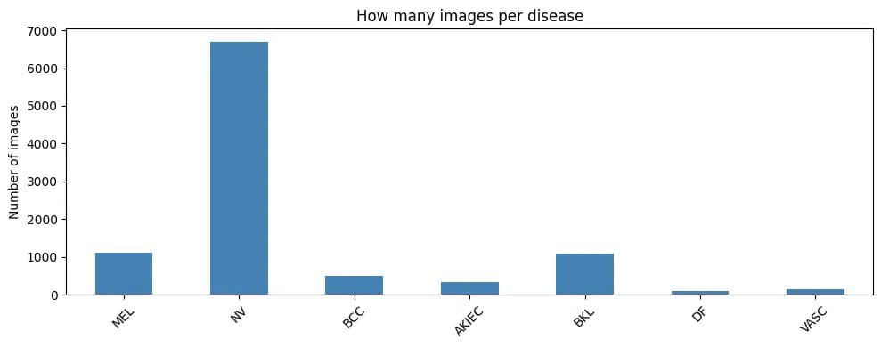
METHODOLOGY · STEP 1
Raw Class Distribution
NV Dominates
NV: ~6,700 images
DF: ~90 images
Reading the imbalance
NV (Melanocytic Nevus) makes up over half of the 11,000+ raw HAM10000 images.
DF and VASC each have well under 200 images — a ratio of roughly 58:1 vs. NV.
This raw skew is exactly why oversampling to 4,023 images per class (Step 2) was necessary.

Slide 11
METHODOLOGY · STEP 1
Clinical Data Preprocessing
Metadata paired with each image — age, sex, lesion site — is cleaned and encoded into a fixed-length numeric vector before multimodal fusion:
1
2
18
Missing Values
Age Normalization
DIM CLINICAL VECTOR
Age imputed with the cohort median; missing sex/site set to an explicit “unknown” category.
Continuous age rescaled with min–max normalization to a fixed 0–1 range for stable MLP training.
Clinical Feature Vector
3
4
Age (normalized) — 1
Sex (encoded) — 1
Localization one-hot — 16
Sex Encoding
One-Hot Encoding
Male / female / unknown mapped to numeric labels via a compact categorical encoding.
15 anatomical lesion sites plus “unknown” expanded into 16 binary indicator columns.
Fused with EfficientNet-B4 + BioBERT features

Slide 12
METHODOLOGY · STEP 2
Class Balancing
Training set was heavily imbalanced (NV ≥58× more common than DF). We kept every majority-class image and oversampled minority classes up to the majority count, then applied a weighted sampler during training.

Slide 13
METHODOLOGY · STEP 3
Data Augmentation
Applied only to training images, to teach the model invariance to imaging conditions and orientation:
1
2
3
Sample training image before augmentation
Random Horizontal / Vertical Flip
Random Rotation (±20°)
Random Resized Crop (0.8–1.0)
Lesions have no canonical orientation
Robust to dermatoscope angle
Simulates zoom / framing variance
4
5
6
Random Affine — Translate & Shear
Color Jitter (brightness/contrast ±0.2)
Random Erasing (p=0.2)
Simulates off-center capture
Robust to lighting & device differences
Simulates hair / occlusion artifacts
Plus ImageNet normalization (mean/std) applied to all splits; evaluation images use only resize + normalize.

Slide 14
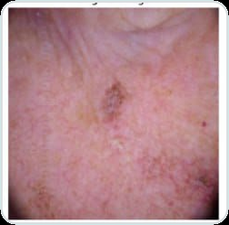
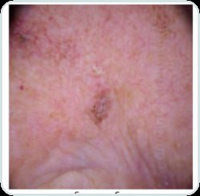
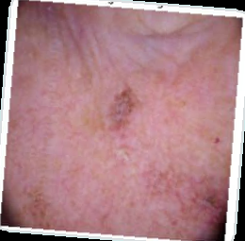
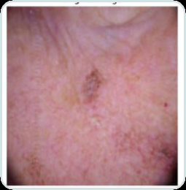
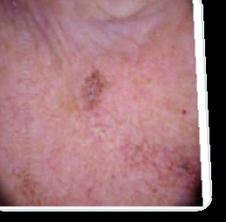
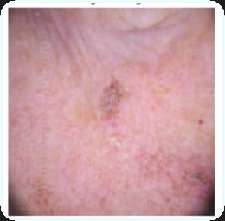
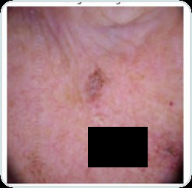
METHODOLOGY · STEP 3 — Augmentation Gallery on Real Hand Lesion
Original
1. Random Horizontal / Vertical Flip
2. Random Rotation (±20°)
3. Random Resized Crop (0.8-1.0)
4. Random Affine — Translate & Shear
5. Color Jitter (brightness/contrast ±0.2)
6. Random Erasing (p=0.2)

Slide 15
METHODOLOGY · STEP 4
Model Architecture
Dermoscopic Image
224×224×3
→
EfficientNet-B4
(ImageNet pretrained)
Classifier Head
Concatenate
Features
Linear(→256) + ReLU + Dropout(0.3)
Linear(256→7) → Softmax
Output: MEL / NV / BCC / AKIEC / BKL / DF / VASC
→
img_dim + 32
Clinical Vector (18-d)
age · sex · 15 body sites
→
MLP: 18→64→32
(ReLU + Dropout 0.2)
Two loss/optimizer/scheduler configurations were trained end-to-end on top of this shared architecture (see next slide).

Slide 16
METHODOLOGY · STEP 5
Training Experiments
Experiment | Optimizer | Loss | Scheduler | Best Val Macro F1
Baseline | Adam (lr 1e-4) | Cross-Entropy | ReduceLROnPlateau | 0.8254
Improved | AdamW (lr 1e-4, wd 1e-4) | Focal Loss (γ=2) | Cosine Annealing | 0.7874
Shared training settings
Winner: Baseline
Max 15 epochs, early stopping patience = 5 (on validation macro F1)
Batch size 32, mixed-precision (AMP) training on GPU
WeightedRandomSampler over the (already balanced) training set
Best checkpoint saved whenever validation macro F1 improved
Plain cross-entropy with class-balanced oversampling outperformed the focal-loss + AdamW + cosine configuration on this already-balanced training set — the extra focal weighting added variance without a clear macro-F1 gain within 15 epochs.

Slide 17
METHODOLOGY · STEP 6
Baseline — Learning Curve
Best Epoch: 12
Val Macro F1 = 0.8254
Val Acc = 88.52%
Reading the curve
Training accuracy climbs smoothly past 98% — the model fits the oversampled data well.
Validation accuracy plateaus near 87–88%, showing a realistic generalization gap.
Macro F1 peaks at epoch 12 then early stopping halts training at epoch 15.

Slide 18
RESULTS
Final Test Performance
86.9%
0.786
0.870
2,003
Test Accuracy
Macro F1
Weighted F1
Test Images
Class | Precision | Recall | F1 | Support
MEL | 0.65 | 0.63 | 0.64 | 223
NV | 0.92 | 0.96 | 0.94 | 1,341
BCC | 0.78 | 0.81 | 0.79 | 103
AKIEC | 0.76 | 0.63 | 0.69 | 65
BKL | 0.82 | 0.68 | 0.74 | 220
DF | 0.89 | 0.74 | 0.81 | 23
VASC | 0.92 | 0.86 | 0.89 | 28
Key takeaways
NV (majority, benign) is classified with 0.94 F1 — the easiest, lowest-risk class.
MEL, the most dangerous class, still trails at 0.64 F1 — the hardest and most clinically important gap to close.
Rare classes (DF, VASC) benefit clearly from oversampling, reaching 0.81–0.89 F1.

Slide 19
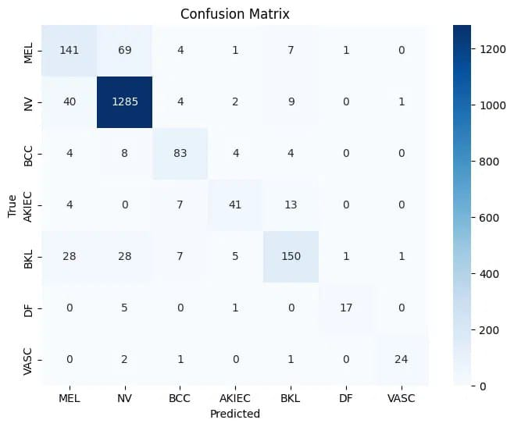
RESULTS
Test Set Confusion Matrix
NV: 1,285 correct
of 1,341 NV cases
MEL: 141 / 223 correct
Reading the matrix
The diagonal is strong for NV, BCC, and VASC — these classes are rarely confused with others.
MEL is most often mistaken for NV (69 cases) — the clinically riskiest confusion in the matrix.
BKL also spreads into MEL and NV (28 each), reflecting visual overlap between benign and malignant pigmented lesions.

Slide 20
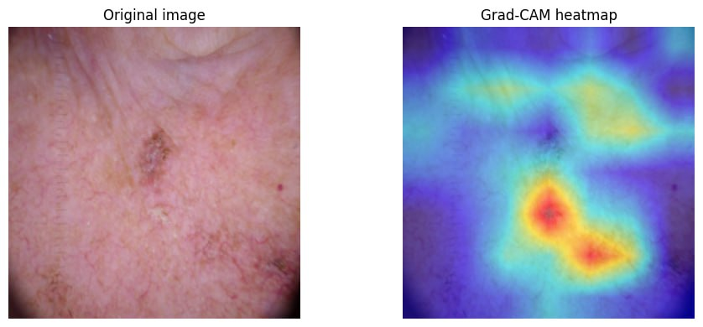
RESULTS · EXPLAINABILITY
Grad-CAM: Seeing What the Model Sees
Attention on the lesion
Why it matters
Clinical role
The warm red/orange region sits directly over the pigmented lesion, not the surrounding skin.
Confirms the network is reasoning from the lesion itself, not rulers, hair, or lighting artifacts in the frame.
Gives dermatologists a visual check on every prediction, the transparency referenced in our stakeholder pitch.

Slide 21

SHIPPING IT
Deployment
Web GUI
→
FastAPI Backend
→
Test-Time Augmentation
→
Risk-Tiered Output
Drag-and-drop image + age / sex / lesion site form
Loads best checkpoint + model_config.json; exposes /predict
Averages predictions over 3 views (original, h-flip, v-flip)
Diagnosis + confidence per class + Critical/High/Moderate/Low tier
Independent ABCDE Symptom Check
The GUI also lets users flag Asymmetry, Border irregularity, Color variation, Diameter >6mm, and Evolving change. This rule-based score is shown as a separate advisory banner alongside the model's result — never merged into the model's training or prediction — so a low-risk model output is never silently overridden by, or confused with, model confidence.

Slide 22







WHAT'S NEXT
Future Work
Lesion Segmentation
Medical Chatbot
Mobile App
Calibrated Confidence
Localize the lesion before classification to reduce background noise.
Guide patients and answer questions while awaiting physician review.
Native camera capture with on-device preprocessing for consistent photos.
Temperature scaling so confidence scores better reflect true risk.
EfficientNet + XGBoost
EfficientNet + Random Forest
EfficientNet + SVM
Gradient-boosted trees on frozen CNN embeddings to lift minority-class recall.
A Random Forest head on CNN features as a lightweight, interpretable alternative.
An SVM classifier on frozen embeddings, well suited to our modest dataset size.

Slide 23
Thank You
Questions & Discussion

